Slide 1
MV* Design Patterns
Model View Design Pattern as three architectural patterns:
MVC (Model-View-Controller)
MVP (Model-View-Presenter) and
MVVM (Model-View-ViewModel)
These patterns have been heavily used for structuring desktop and server-side applications.
@ShankaragoudaG

Slide 2
MVC Design Pattern
It enforces the isolation of business data (Models) from user interfaces (Views), with a third component (Controllers) traditionally managing logic and user input.
The pattern was originally designed by Trygve Reenskaug during his time working on Smalltalk-80 (1979) where it was initially called Model-View-Controller-Editor.
MVC most suitable for web-based enterprise-level applications architectures.

Slide 3
Smalltalk-80’s MVC architecture
A Model represented domain-specific data and was ignorant of the user interface (Views and Controllers). When a model changed, it would inform its observers.
A View represented the current state of a Model. The Observer pattern was used for letting the View know whenever the Model was updated or modified.
Presentation was taken care of by the View, but there wasn’t just a single View and Controller—a View-Controller pair was required for each section or element displayed on the screen.
The Controller’s role in this pair was handling user interaction (such as key presses and actions such as clicks), making decisions for the View.

Slide 4
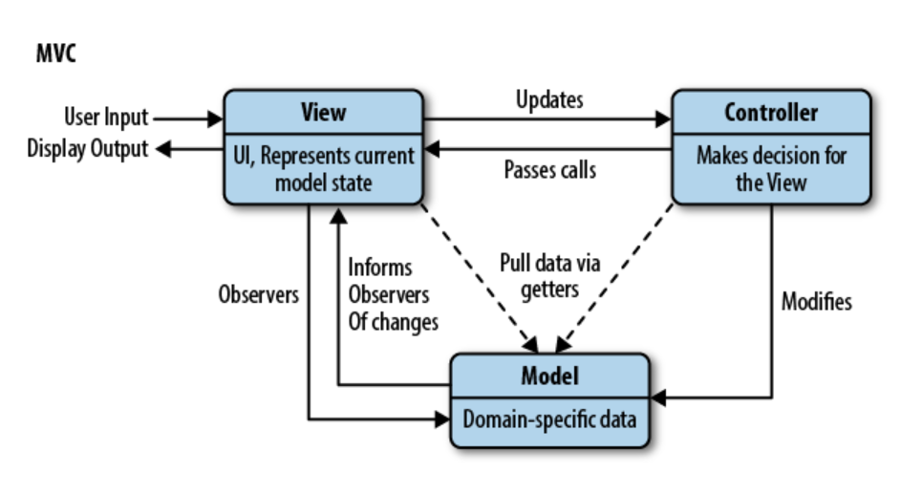
MVC Pattern Diagram

Slide 5
MVC Pattern Frameworks
Backbone.js
AngularJS
Knockout
Ember.js
ExtJS
CanJS
Kendo UI

Slide 6
MVC Pattern
Advantages of MVC architecture pattern:
MVC pattern increases the code testability and makes it easier to implement new features as it highly supports the separation of concerns.
Unit testing of Model and Controller is possible as they do not extend or use any Android class.
Functionalities of the View can be checked through UI tests if the View respect the single responsibility principle(update controller and display data from the model without implementing domain logic)
Disadvantages of MVC architecture pattern:
Code layers depend on each other even if MVC is applied correctly.
No parameter to handle UI logic i.e., how to display the data.

Slide 7
MVC Pattern Example
https://www.taniarascia.com/javascript-mvc-todo-app/

Slide 8
MVP Design Pattern
Model-view-presenter (MVP) is a derivative of the MVC design pattern which focuses on improving presentation logic.
It originated at a company named Taligent in the early 1990s while they were working on a model for a C++ CommonPoint environment.
The MVP design pattern is preferred over MVC when your application needs to provide support for multiple user interface technologies. It is also preferred if you have complex user interface with a lot of user interaction.

Slide 9
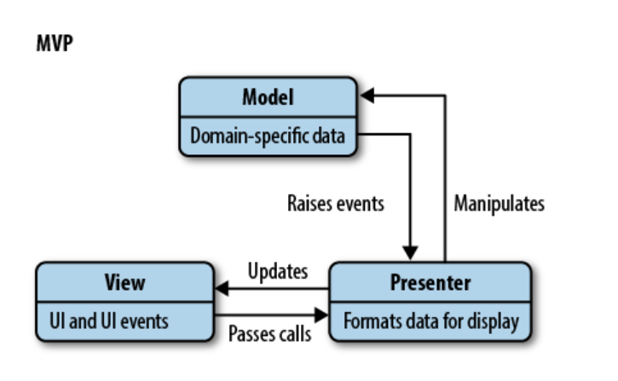
MVP Pattern Diagram
The P in MVP stands for presenter. It’s a component that contains the user-interface business logic for the view. Unlike MVC, invocations from the view are delegated to the presenter, which are decoupled from the view and instead talk to it through an interface. This allows for all kinds of useful things, such as being able to mock views in unit tests.

Slide 10
MVP Pattern Frameworks
ASP.NET
GWT (Google Web Toolkit)
Abstract Window Toolkit
Standard Widget Toolkit
CodeIgniter
Laravel
Nette Framework
Backbone.js

Slide 11
MVP Pattern
Advantages of MVP Architecture:
No conceptual relationship in android components
Easy code maintenance and testing as the application’s model, view, and presenter layer are separated.
Disadvantages of MVP Architecture:
If the developer does not follow the single responsibility principle to break the code then the Presenter layer tends to expand to a huge all-knowing class.

Slide 12
MVP Example
https://www.educative.io/collection/page/5429798910296064/5725579815944192/4966643919749120

Slide 13
MVVM Design Pattern
MVVM (Model View ViewModel) is an architectural pattern based on MVC and MVP, which attempts to more clearly separate the development of user interfaces (UI) from that of the business logic and behavior in an application.
This facilitates UI and development work occurring almost simultaneously within the same code base. UI developers write bindings to the ViewModel within their document markup (HTML), where the Model and ViewModel are maintained by developers working on the logic for the application.

Slide 14
MVVM Design Pattern
MVVM (by name) was originally defined by Microsoft for use with Windows Presentation Foundation (WPF) and Silverlight, having been officially announced in 2005 by John Grossman in a blog post about Avalon (the codename for WPF).
It also found some popularity in the Adobe Flex community as an alternative to simply using MVC.
MVVM has been implemented in JavaScript in the form of structural frameworks such as KnockoutJS, Kendo MVVM, and Knockback.js.

Slide 15
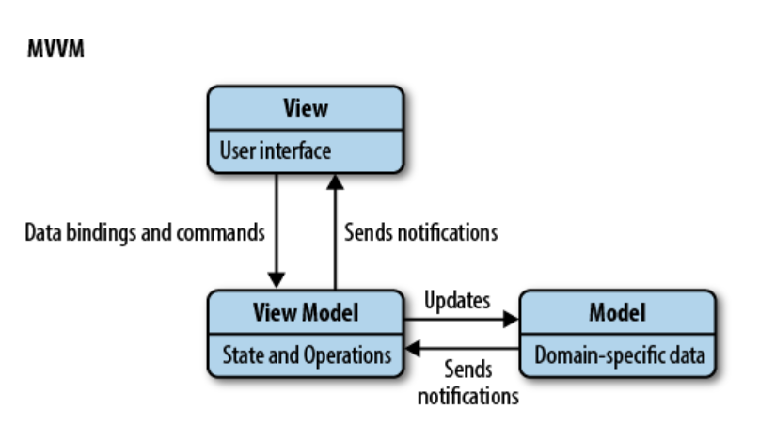
MVVM Pattern Diagram
The ViewModel can be considered a specialized Controller that acts as a data converter. It changes Model information into View information, passing commands from the View to the Model.

Slide 16
MVVM Framewroks
Angular
Aurelia
Durandal
Ember.js
Ext JS
Knockout.js
Omi.js
Oracle JET
Reactjs
Svelte
Vue.js

Slide 17
MVVM Pattern
Advantages:
MVVM facilitates easier parallel development of a UI and the building blocks that power it.
MVVM abstracts the View and thus reduces the quantity of business logic (or glue) required in the code behind it.
The ViewModel can be easier to unit test than in the case of event-driven code.
The ViewModel (being more Model than View) can be tested without concerns of UI automation and interaction.
Disadvantages:
For simpler UIs, MVVM can be overkill.
While data bindings can be declarative and nice to work with, they can be harder to debug than imperative code where we simply set breakpoints.
Data bindings in nontrivial applications can create a lot of bookkeeping. We also don’t want to end up in a situation where bindings are heavier than the objects being bound to.
In larger applications, it can be more difficult to design the ViewModel up front to get the necessary amount of generalization.

Slide 18
MVVM Example
https://www.educative.io/collection/page/5429798910296064/5725579815944192/5161641743220736

Slide 19
MVC vs MVP vs MVVM
In MVC, the View sits on top of our architecture with the controller beside it. Models sit below the controller, so our Views know about our controllers and controllers know about Models. Here, our Views have direct access to Models. Exposing the complete Model to the View, however, may have security and performance costs, depending on the complexity of our application. MVVM attempts to avoid these issues.
In MVP, the role of the controller is replaced with a Presenter. Presenters sit at the same level as views, listening to events from both the View and model, and mediating the actions between them. Unlike MVVM, there isn’t a mechanism for binding Views to ViewModels, so we instead rely on each View implementing an interface allowing the Presenter to interact with the View.
MVVM consequently allows us to create View-specific subsets of a Model, which can contain state and logic information, avoiding the need to expose the entire Model to a View. Unlike MVP’s Presenter, a ViewModel is not required to reference a View. The View can bind to properties on the ViewModel, which in turn expose data contained in Models to the View. As we’ve mentioned, the abstraction of the View means there is less logic required in the code behind it.

Slide 20
Useful Resources
https://www.oreilly.com/library/view/learning-javascript-design/9781449334840/ch10.html
https://www.patterns.dev/posts/classic-design-patterns/#detailmvcmvp

